Slide 1
FamInsure Company
Executive Presentation

Slide 2
Problem Statement
FamInsure accountants have noticed that the medical expenses have slowly increased over the last 5 years, meaning that the company is now paying 10% more than it did in the past.
While actuaries and underwriters are calculating the costs for what the members should be paying, an analysis is requested for other cost-cutting measures.
By December 31, 2025, FamInsure will reduce its medical costs by 8% through evaluation of where most expenses occur in medical payouts.

Slide 3
FamInsure Inquiry to Reduce Medical Charges
Premise: The Medical Insurance Charges increase costs for the company.
Goal: Reduce costs through an inquiry on where highest charges come from.
Inquiry: Medical costs dependent on…
Body Mass Index (BMI);
Region/ Geography;
Gender*;
Age
Smoking.
* This data was collected prior to our updated data collection practices regarding gender.

Slide 4
BMI reveals an impact on medical charges. Overweight patients constituted the majority of all customers (54%) and made up for the majority of average costs ($15k). Even though Underweight customers made up only 2% of the population, their charges were responsible for 19% of the total average charges.
Slightly Overweight

Slide 5
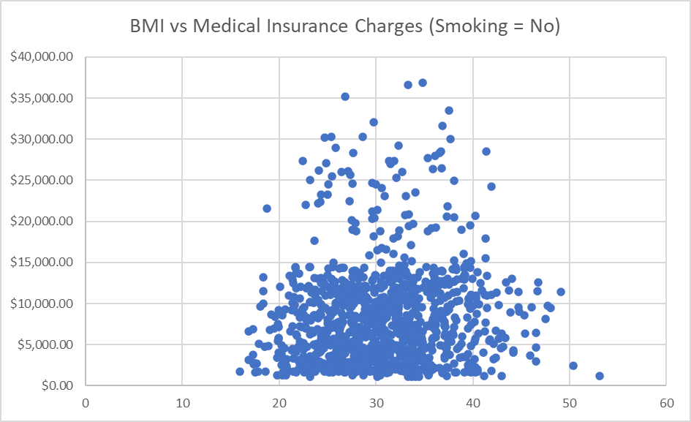
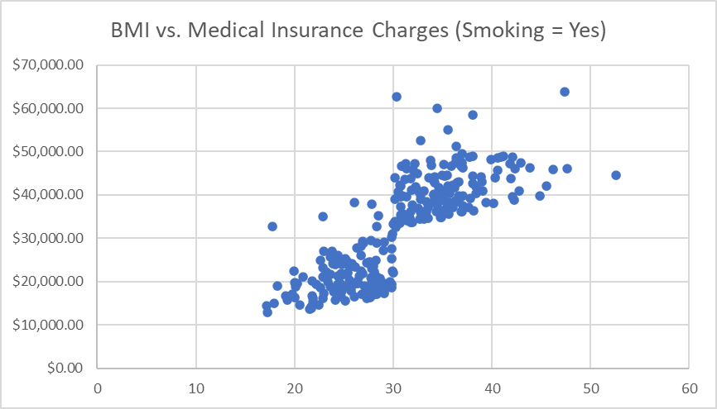
BMI and Smoking As BMI increases in the “Smoking=Yes” scatter plot, so does cost. The “Smoking=No” scatter plot shows a higher prevalence of lower costs.

Slide 6
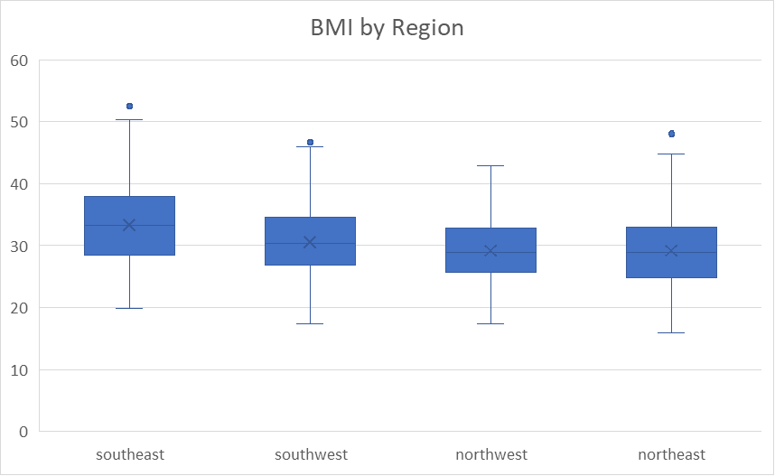
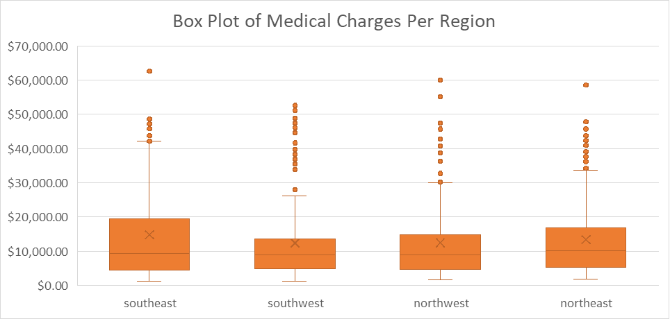
Region offers little to no evidence of being a strong indicator of medical charges. Region shows a ~$770 difference between the average SE cost (highest at $13.73k) and the average SW cost (lowest at $12.96k). The SE region may be explained by an extreme outlier and an interquartile range which extends to almost $20k.

Slide 7
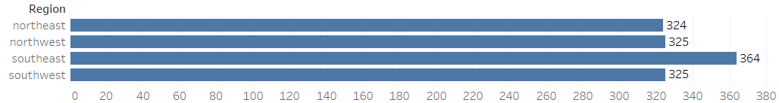
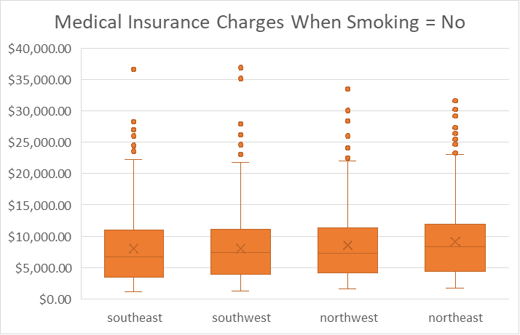
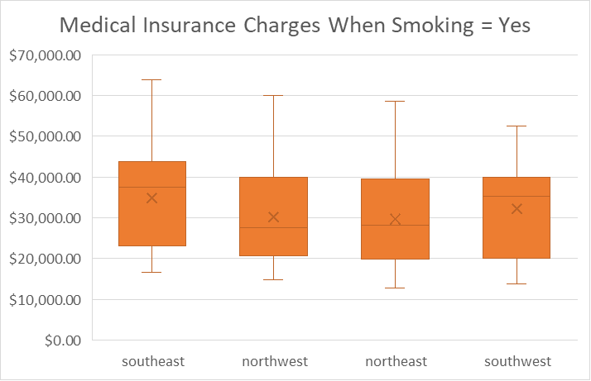
Region and Smoking. The majority of smokers reside in the Southeast (364), where the average medical smoking charges are higher than other regions (average ~$35k) and have a much wider range of expenses moving towards $65k.
Count of Smokers by Region

Slide 8
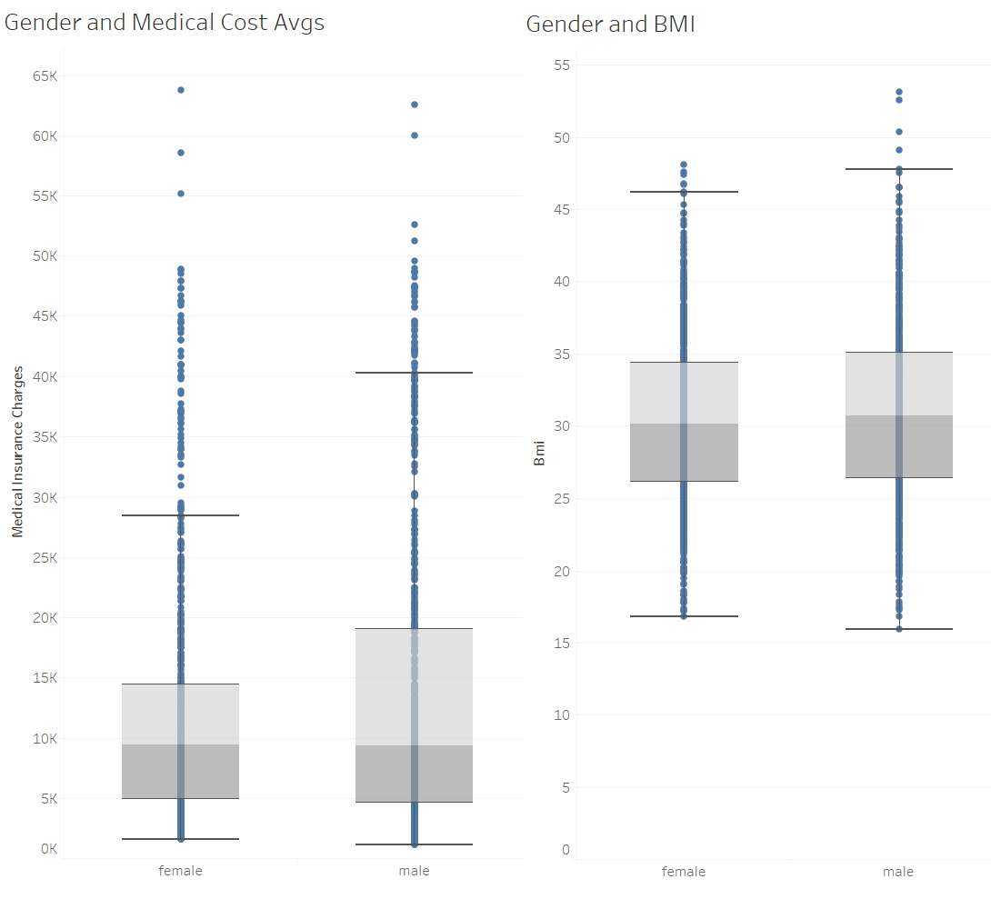
Gender reveals little impact or bearing on insurance costs (~$1,387 difference). Male charges appear higher due to a larger interquartile spread of higher costs (between $5k and ~$20k) and slightly higher BMI number range, especially above BMI of 50.
* This data was collected prior to our updated data collection practices regarding gender.

Slide 9
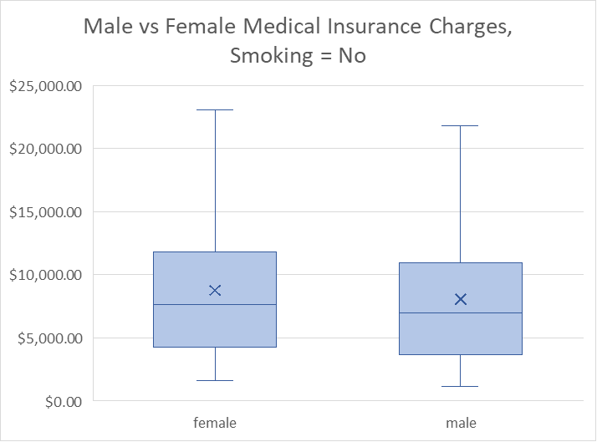
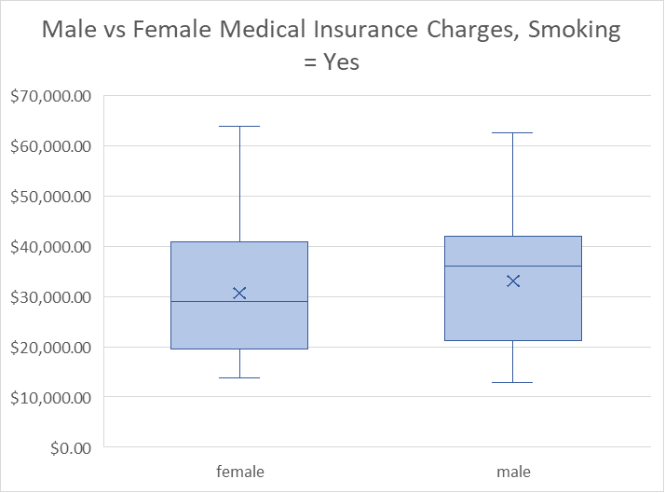
Gender and Smoking. There is minimal difference between men and women who smoke, and the more noticeable difference between non-smokers and smokers when looking at medical charges. Female smokers had an average of $30.7k medical charges and non-smokers averaged $8.8k. Male smokers had an average of $33k in medical charges with non-smokers averaging $8k.

Slide 10
Age is a natural factor related to medical costs. Seniors comprised 38% of all costs, with Mature Age Adults following at 27%. When smoking is included, the average costs become higher for all age groups with a roughly $25k increase.

Slide 11
Correlational Evidence. The closer a number is to 1 or -1, the more likely there is a relationship. The takeaway shows that every factor from Northeast to the left is considered to have some level of positive relationship (even if not high enough to make a difference) with higher medical charges. Main factors summarized next page.

Slide 12

Executive Summary
Highest Medical Charges:
Smoking;
Being over 60;
Overweight BMI.
Recommendations:
Screen for smoking;
Program to help quit?
Fitness and Health Goals/Programs;
Health Education;
Rewards for non-smoking/health goals;
Large focus on SE region.
Notes:
Smoking and being over the age of 60 appear to create the highest medical charges, with having an overweight BMI another considerable factor. When these factors are combined, the risk for higher costs increases. Being in the SE could also be a cause, but that was ruled out due to the outlier and its averages/interquartile range being similar to other regions.
Recommendations: Screen for smokers. Encourage fitness and health programs for all groups, especially higher BMI and Seniors. Partner with companies – extra time off for non-smokers?

